Slide 1



Oracle Database
Novas Características
12c
Everton Sparenberger Dias
Database Solutions
Oracle Open World Latin America
4-6 Dezembro, Expo Center – São Paulo

Slide 2








Arquitetura Atual
Memória e processos dedicados para cada banco de dados
ERP
Memory
Utilized
Background
Processes
Database
Files
RAM

Slide 3
Arquitetura Atual
Memória e processos dedicados para cada banco de dados
ERP
CRM
DW
Memory
Utilized
Background
Processes
Database
Files
Memory
Utilized
Background
Processes
Database
Files
Memory
Utilized
Background
Processes
Database
Files
RAM
RAM
RAM

Slide 4






Nova Arquitetura (Pluggable Database)
Memória e processos foram movidos para o container (CDB)
ERP
CRM
DW
Memory
Utilized
Background
Processes
Database
Files
Memory
Utilized
Background
Processes
Database
Files
Memory
Utilized
Background
Processes
Database
Files
RAM
RAM
RAM
Notes:
Add New in title

Slide 5








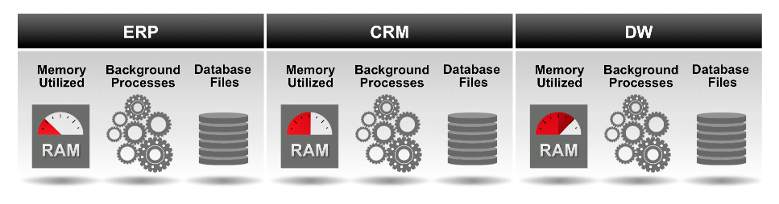
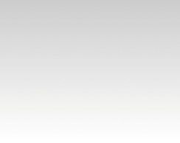
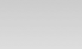
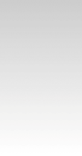
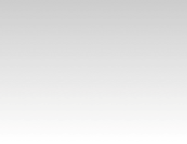
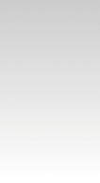
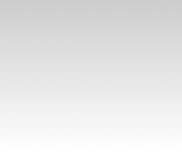
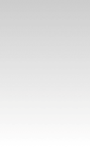

Nova Arquitetura (Pluggable Database)
Memória e processos foram movidos para o container (CDB)
Memory
Utilized
Background
Processes
Container Database
RAM
ERP
CRM
DW

Slide 6
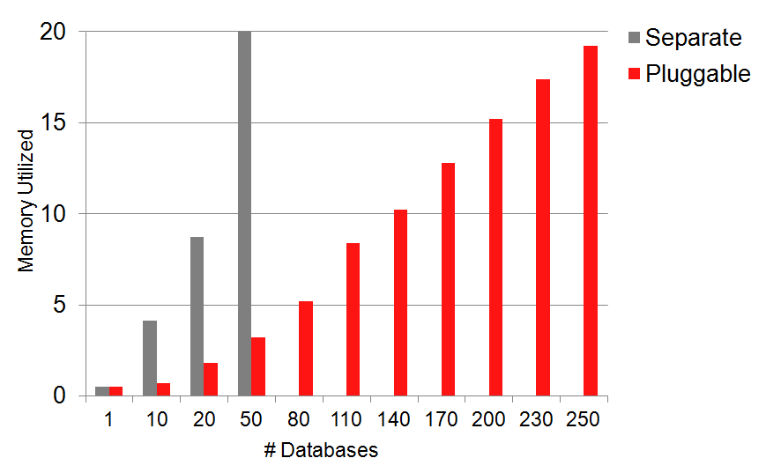
Consolidação
Benchmark OLTP

Slide 7
Isolamento
Gerenciamento de recursos
Container Database (12.1)
ERP
CRM
12.1
DW
DW
Top Priority
Medium Priority
Low Priority

Slide 8

Upgrade e Consolidação
Método 1 (Upgrade In-Place)

Slide 9








Upgrade e Consolidação
Passo 1: Realizar o upgrade normalmente
Memory
Utilized
Background
Processes
Container Database
RAM
10.2
ERP
11.1
CRM
11.2
DW
Upgrade
in-place
12.1
ERP
12.1
CRM
12.1
DW

Slide 10
Upgrade e Consolidação
Passo 2: Plugar no container
Memory
Utilized
Background
Processes
Container Database
RAM
12.1
ERP
12.1
CRM
12.1
DW
12.1
ERP
12.1
CRM
12.1
DW

Slide 11
Upgrade e Consolidação
Método 2 (from scratch)

Slide 12
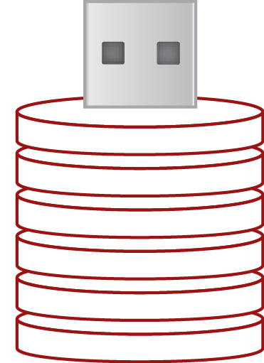
Upgrade e Consolidação
Passo 1: Criar databases vazios (PDBs) para consolidação
Memory
Utilized
Background
Processes
Container Database
RAM
ERP
CRM
DW

Slide 13
Upgrade e Consolidação
Passo 2: Migração lógica com Datapump ou Golden Gate
Memory
Utilized
Background
Processes
Container Database
RAM
12.1
ERP
12.1
CRM
12.1
DW
ERP
CRM
DW
01100101001010010
11 0110001000101001
001100110001010010
1010100010111010010
01001001010100010
01100101001010010
11 0110001000101001
001100110001010010
1010100010111010010
01001001010100010
01100101001010010
11 0110001000101001
001100110001010010
1010100010111010010
01001001010100010
Data Pump or GoldenGate
10.2
ERP
11.1
CRM
11.2
DW

Slide 14
Correções e Upgrades
Futuros

Slide 15
Aplicação de Patches e Upgrades Futuros
Aplique no CDB e todos os PDBs serão afetados
Upgrade
in-place
Container Database
12.1
ERP
12.x
ERP
12.1
CRM
12.x
CRM
12.1
DW
12.1
DW
12.x
DW

Slide 16
“Unplug” e “Plug” conforme desejado
Flexibilidade para aplicar correções e upgrades
Original Container Database (12.1)
Upgraded Container Database (12.x)
12.1
ERP
12.1
CRM
12.1
DW
12.x
CRM
12.1
CRM
12.1
DW
12.x
DW

Slide 17
Gerenciamento

Slide 18
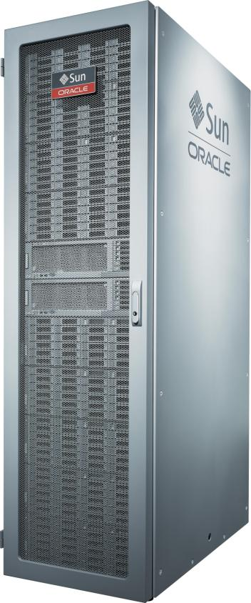

Gerencie diversos como se fossem um
Backup ao nível de CDB, Recover no nível de PDB
Production Container Database
CDB Backup
ERP
CRM
DW
Point-in-time recovery
no nível de Pluggable Database

Slide 19
Gerencie todos DBs como se fossem um
Um standby para o CDB cobre todos os PDBs
Production Container Database
Standby Container Database
ERP
CRM
DW
HCM
ERP
CRM
DW
HCM

Slide 20
Gerenciando
Ambientes Não Produtivos

Slide 21
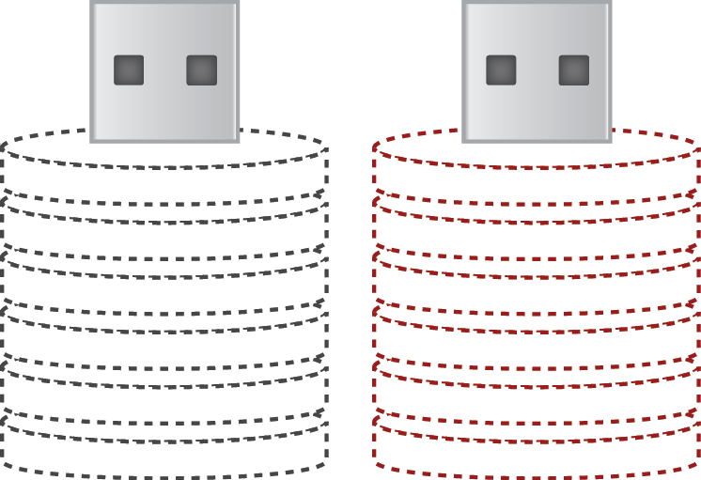
Databases para Teste e Desenvolvimento
Clonagem rápida e flexível dos pluggable databases
Production Container Database
Development Container Database
ERP
Dev
Copy
ERP
Test Copy
ERP
CRM
DW
ERP
Test Copy

Slide 22




Self Contained Databases
Multitenant Database Architecture Enables the Hybrid Cloud
On Premises
Hybrid Cloud
Oracle Cloud
Mesma Arquitetura
Mesmo Software
Mesmo Conhecimento

Slide 23
In-Memory
Performance para OLTP e OLAP
Notes:
This slide can also be used as a Q and A slide

Slide 24

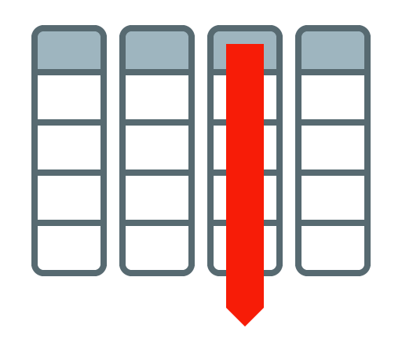





In Memory Database
Dual format (OLTP & OLAP) para a mesma tabela
Memória
Memória
Vendas
Vendas
Formato em linha
Formato colunar
VENDAS

Slide 25
In Memory Database
Por que o In-Memory Scan é mais rápido que o buffer cache?
Buffer Cache
SELECT COL4 FROM TABELA;
X
X
X
X
Resultado
X
Formato em Linha
Notes:
One of the most commonly asked questions when folks hear about the new In-Memory
column store is “why is it faster than just pinning an object in the buffer cache”?
So lets spend a little time comparing the two data access methods.
When you issue a query select col 4 from mytable and mytable is in the buffer we
access the data by finding the offset of the first row in the table and walking along
that row until we find col4. We then pick up that value and jump to the offset of the next row.
We keep doing this until we have reached the end of the table.

Slide 26


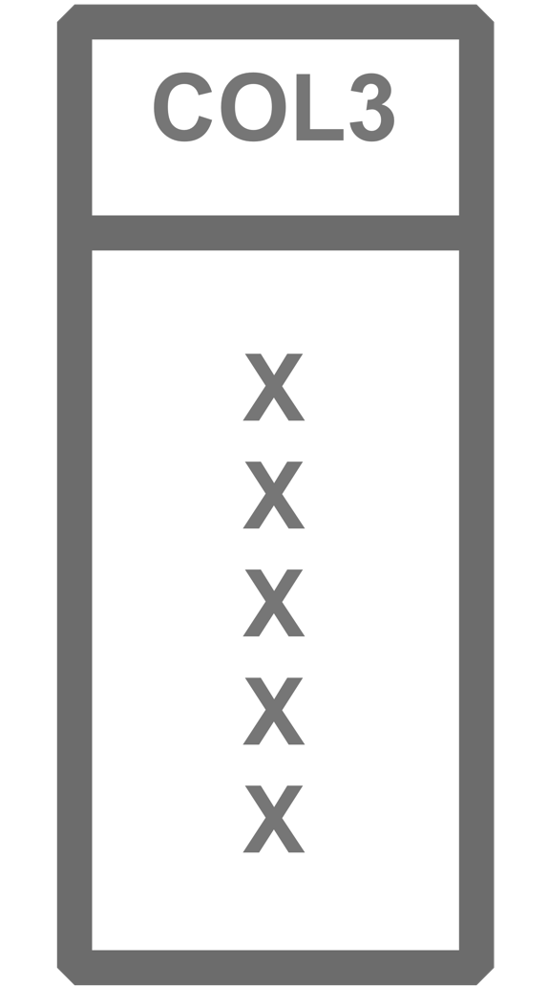
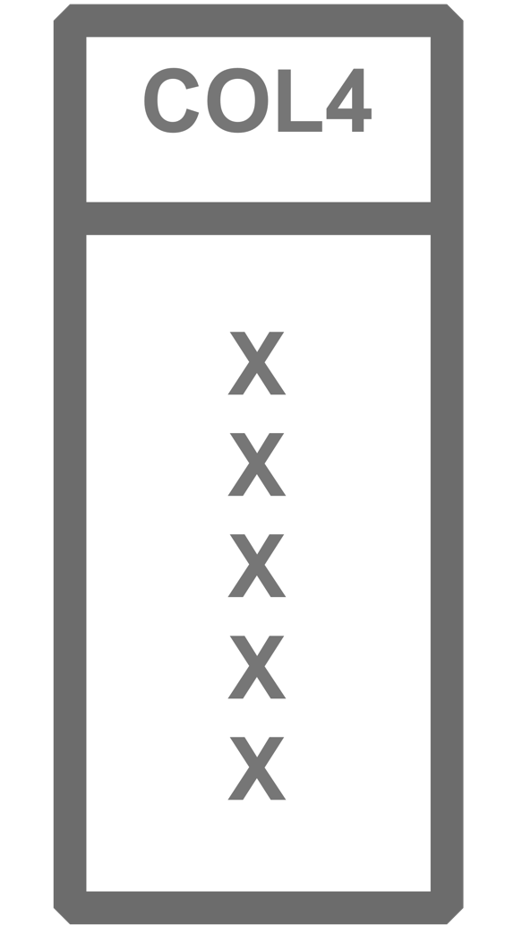

In Memory Database
Por que o In-Memory Scan é mais rápido que o buffer cache?
IM Column Store
SELECT COL4 FROM MYTABLE;
RESULT
Resultado
X
X
X
Formato em Coluna
X
Notes:
In the column store the query behaves very differently.
Because the data is store is separate physical column structures
we just go directly to the col4 structure and scan all the entries, one after the other.
REASON 1 only access the data you need for the query
The volume of data accessed when we scan col4 is also less as the col4 is compressed in the
In-Memory column store. Remember the new memcompress algorithms
REASON 2 Queries predicates applied directly to the compressed data

Slide 27
In Memory Database
Fácil, rápido e sem alteração da aplicação
  Configure a capacidade de memória
    inmemory_size = XXX GB
  Configure tabelas e partições em memória
    alter table | partition … inmemory;
  Drop indices analíticos para melhorar o OLTP

Slide 28
ILM
Information Lifecycle Management
Notes:
This slide can also be used as a Q and A slide

Slide 29
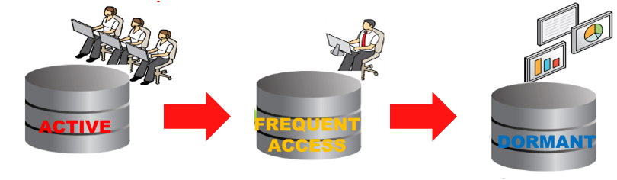
Padrões de acesso aos dados
Armazenamento
Copyright © 2013, Oracle and/or its affiliates. All rights reserved.
Confidential – Oracle Restricted

Slide 30
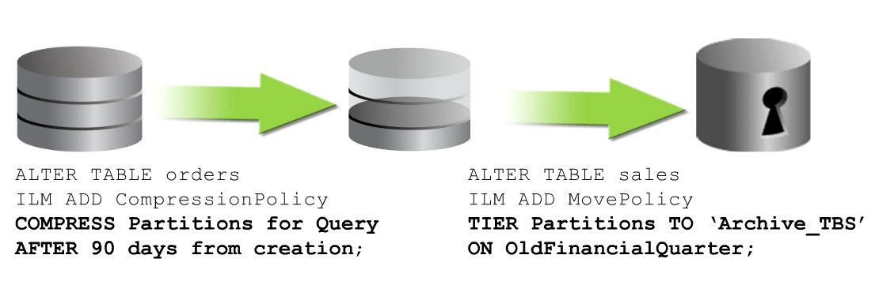
Otimização Automática de Dados
Compressão e Organização
30
Copyright © 2013, Oracle and/or its affiliates. All rights reserved.
Confidential – Oracle Restricted

Slide 31
Flex ASM
Compartilhamento de instâncias ASM
Notes:
This slide can also be used as a Q and A slide

Slide 32
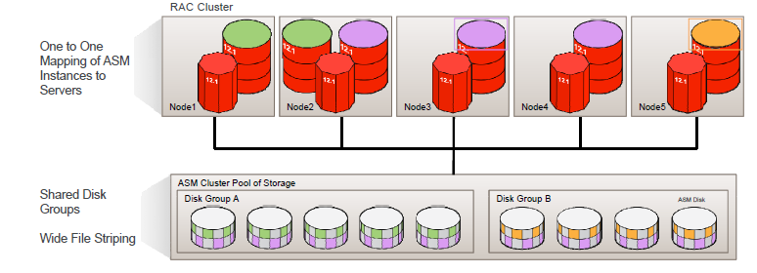
Flex ASM
Configuração 12.1 Business as Usual (1:1)
32
Copyright © 2013, Oracle and/or its affiliates. All rights reserved.
Confidential – Oracle Restricted

Slide 33
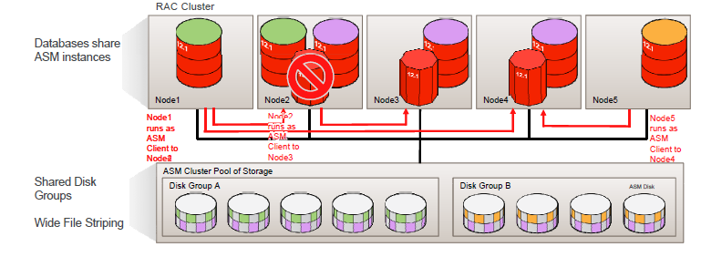
Flex ASM
Compartilhamento de instâncias ASM
33
Copyright © 2013, Oracle and/or its affiliates. All rights reserved.
Confidential – Oracle Restricted

Slide 34
Segurança
Data Redaction
Notes:
This slide can also be used as a Q and A slide

Slide 35


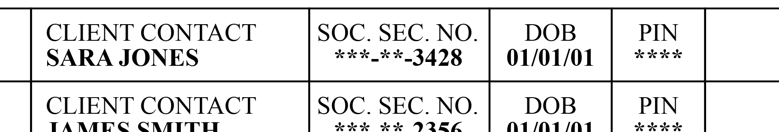

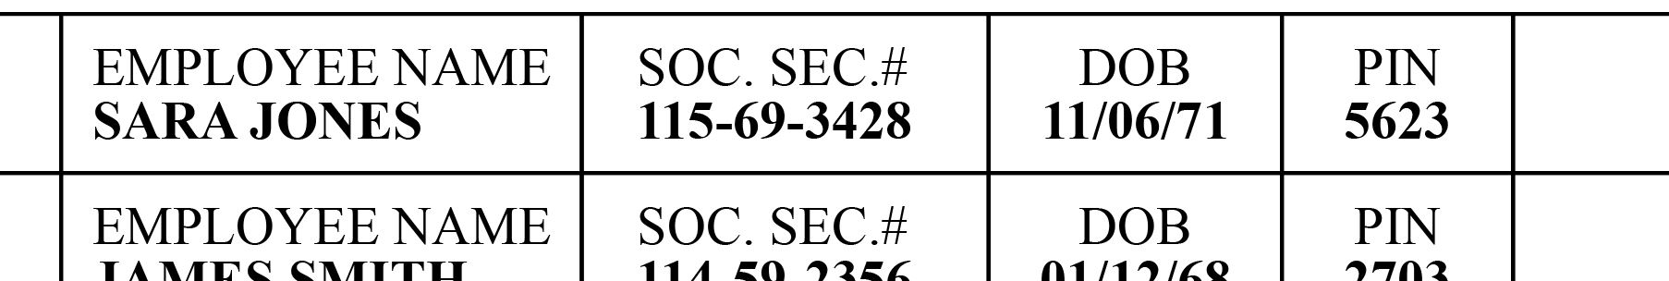
Proteção Dinâmica para dados sensíveis
Data Redaction
Operador de Call Center
Redige dados sensíveis de acordo com a política aplicada
Soc. Sec. #
115-69-3428
DOB
11/06/71
PIN
5623
Gestor do Call Center

Slide 36
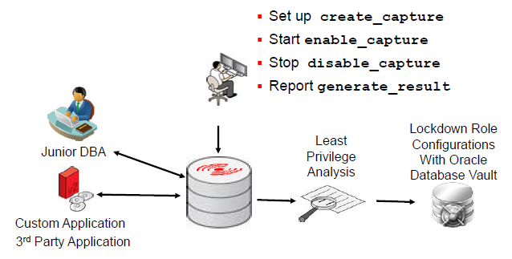
Análise de Privilégios em Tempo Real
Suporte para definição de privilégios mínimos

Slide 37
Backup
Recuperação de tabela
Notes:
This slide can also be used as a Q and A slide

Slide 38
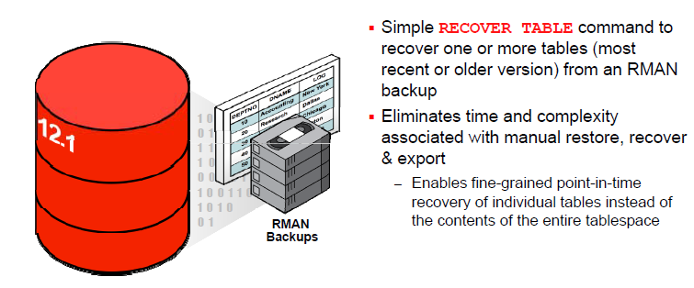
Recuperação de Tabela
RMAN
Notes:
- Não Requer área de stage.

Slide 39
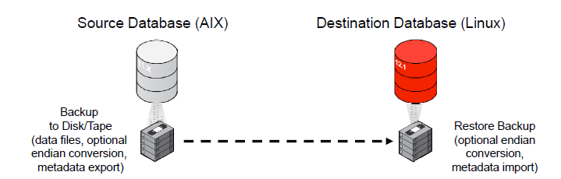
Backup e Restore em Plataformas Distintas
Procedimento simplificado
Notes:
- Não Requer área de stage.

Slide 40
Gerenciamento
Melhorias no gerenciamento
Notes:
This slide can also be used as a Q and A slide

Slide 41
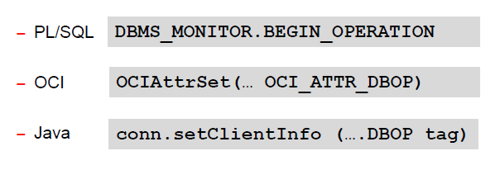
Monitoração de Aplicação em Tempo Real
Como habilitar
Notes:
- Data pump recebe uma tag automaticamente.

Slide 42
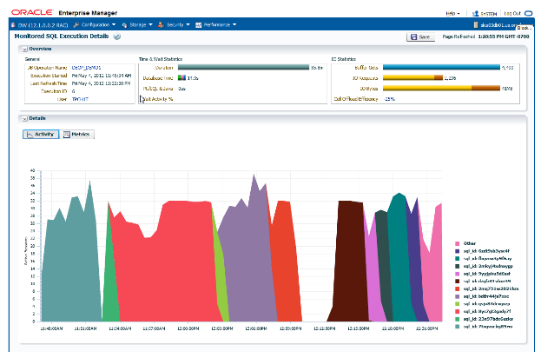
Monitoração de Aplicação em Tempo Real
Orientado à aplicação

Slide 43

Validando a Estratégia de Consolidação
Análise de consolidação
ERP
Container Database
CRM
ERP
CRM
DW
DW

Slide 44
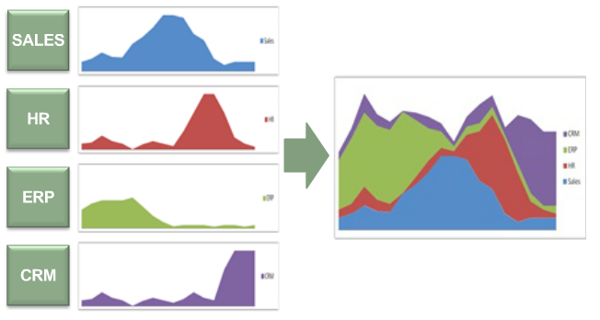
Validando a Estratégia de Consolidação
Análise de Consolidação

Slide 45
Validação Temporal
Melhorias no gerenciamento
Notes:
This slide can also be used as a Q and A slide

Slide 46
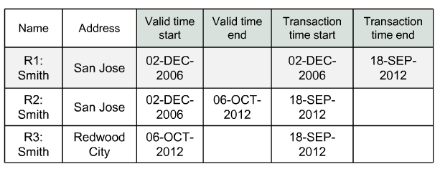
Validação Baseada no Tempo
Valid Time Temporal
Notes:
Exemplo: Mudança futura de endereço.

Slide 47
Alta Disponibilidade
Novas funcionalidades
Notes:
This slide can also be used as a Q and A slide

Slide 48
Alta Disponibilidade
Novas funcionalidades para RAC
Transaction Guard
Protocolo e API confiáveis que retornam o resultado da última transação
Application Continuity:
Em caso de indisponibilidade faz um replay da transação de forma transparente;

Slide 49
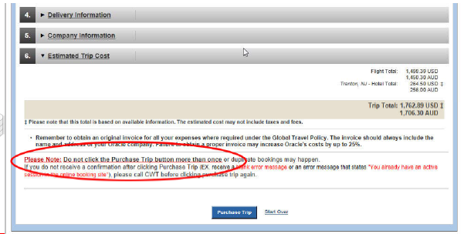
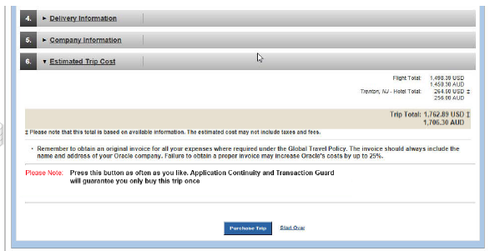
Transaction Guard
Oracle Travel
Notes:
At-Most-Once for transactions

Slide 50
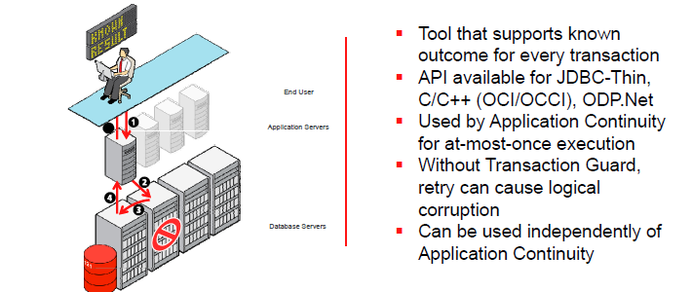
Transaction Guard
Primeiro Database a preservar o resultado do commit

Slide 51
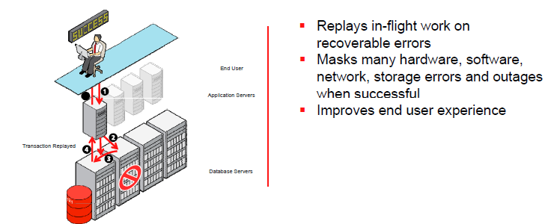
Application Continuity
Refaz a transação em caso de falhas
Notes:
At-Most-Once for transactions

Slide 52
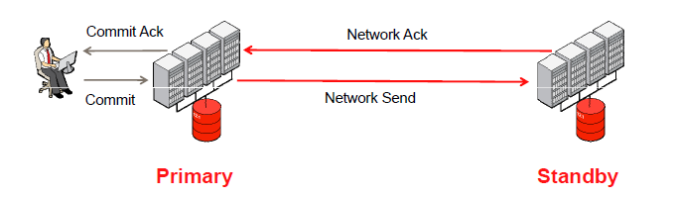
Dataguard (Zero Data Loss)
Trade-off entre performance e segurança

Slide 53
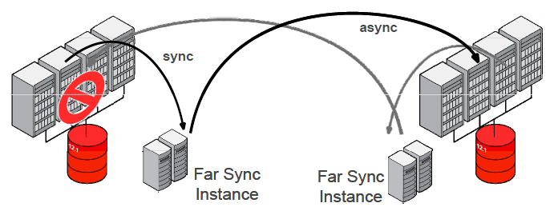
Dataguard Far Sync
Zero Data Loss

Slide 54
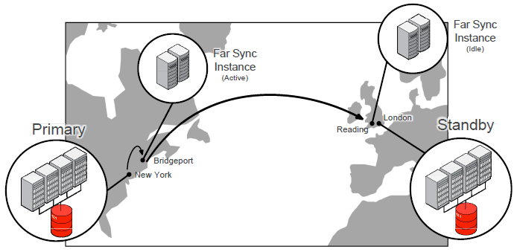
Dataguard Far Sync
Zero Data Loss

Slide 55
Sharding
Horizontal partitioning of data across independent databases (shards)
Notes:
This slide can also be used as a Q and A slide

Slide 56
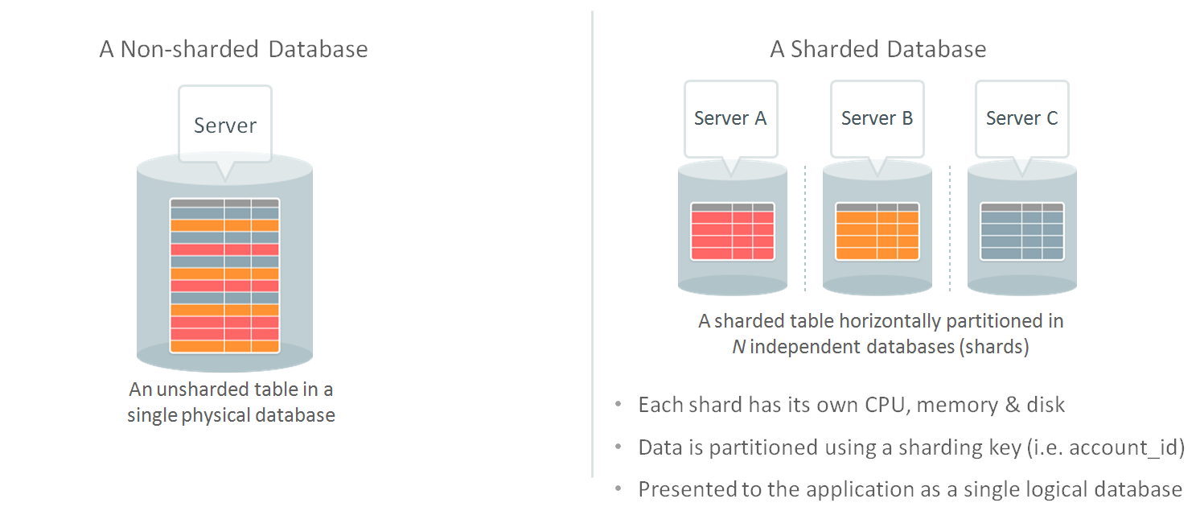
Sharding
Escalabilidade linear com tolerância a falhas

Slide 57
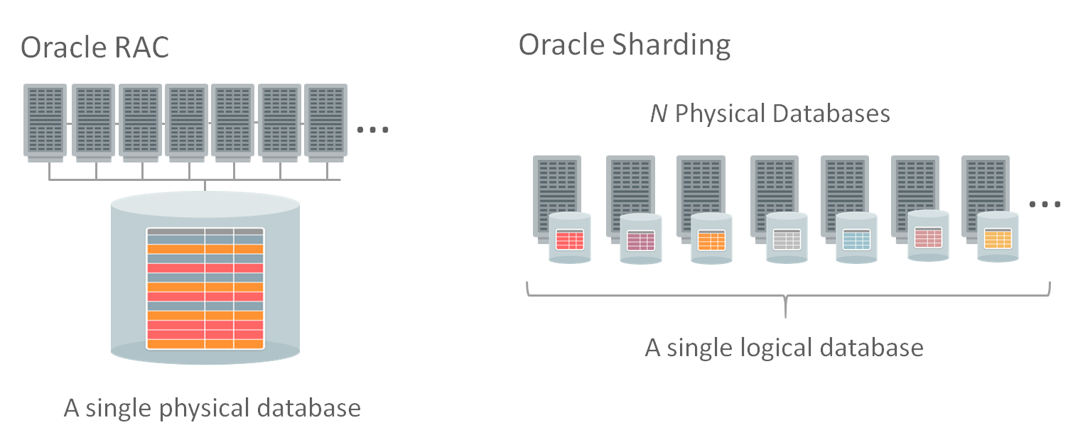
Sharding
Escalabilidade linear com tolerância a falhas

Slide 58
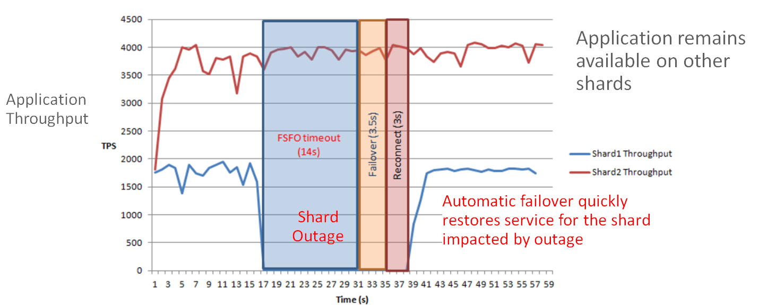
Sharding
Escalabilidade linear com tolerância a falhas

Slide 59
Faster Performance
Database
Creation
Database
Upgrade
Adaptive Query
Optimization
Parallel
Execution
Large Parallel
Sorts
Parallel
Union All
Up to 1000x faster
Up to 40% faster
Up to 6x faster
Up to 4x faster
Up to 2x faster
Up to 4x faster
Materialized
View Refresh
Asynchronous
Global Indexes
String operations
in PL/SQL
Spatial Queries
Network
Encryption
Auditing
Instant partition maintenance
Up to 5x faster
Up to 30x faster
Up to 40x faster
Up to 10x faster
Up to 5x faster
Notes:
We have many more performance proof points, but choose 12 because we think 12 is a good number. Details below.
======================================================
Database Creation: Comparing old style Create Database with Create Pluggable Database
===========================
Upgrades improved with parallel upgrades, lots of 11.2.0.3 test results (where this was introduced).. You can upgrade a (simple) database in at little as 6 minutes
You can upgrade an SAP database 35% faster, Parallel upgrade can be 25-40% faster than serial upgrade
==============================
Adaptive Query Optimization
Various EBS reports (AR, PA) running on Oracle GSI
=======================
Improved parallel execution and SQL scalability: up to 2x faster
- This is for two main areas: (1) all the things done on the PX side, e.g. better skew handling, PX selector, etc. etc. and (2) SQL scalability, e.g. window function scalability (in presence low ndv and skew - this is adaptive and can achieve perf impr on the order of DOP times, have 3-4x), rollup scalability(in presence low ndv and skew - ), group - by scalability (we always push group by and have adaptive cutof - 30-50% better). From perf improvements we did better aggregation on float/double (30%).
===========================
Large Parallel Sorts
Remove train effect (In 11.2, parallel sort a slave runs out of memory and spills. This caused serailization of sort (train effect). We removed it by forcing all slaves to spill once on spills. Adpative. Slaves spill at the same time, and not one-by-one serializing sort.Perf: 2x
==============================
Concurrent UNION ALL (verified by customer load of data from serial sources)
Serial Branches of UA run concurrently. 2x-4x
===============================
MV Refresh: up to 5x faster
- We get 2-3x for pk-fk improvements and for sync-refresh 5x.
===========================
Asynchronous global index maintenance: up to 100x faster TRUNCATE and DROP PARTITION
================================
String Operations in PL/SQL:
This was a joint project between our team and Iyer's team. The performance data as well as the testcase used is at the URL given below(** trying to find URL PA 9/28**). It provided improvements in the range of 10.5x-29.3x for small lob concatenations, 3.5x-4.9x for large lob concatenations, and 1.1x-7.8x for other string operations.
=======================
Spatial:Up to 40x performance improvement for Oracle Spatial queries for core functions such as GEOM.DISTANCE: (This is as the crow flies. HOW FAR IS HQ FROM THE BART STATION?). Even bigger performance improvements with vector operations in Oracle Spatial (not DB Locator feature) due to algorithm enhancements. We are calling this feature "vector performance acceleration". It should also be true for large-scale raster operations because of new parallel capabilities. In this case it is the ability to exploit and scale with additional hardware.
==========================
Auditing: Up to 5x (comparing writing audit trail to database in 11g)
=======================
Network Encryption: Up to 10x (with disclaimer on Intel or SPARC CPUs with crypto acceleration)
==========================

Slide 61
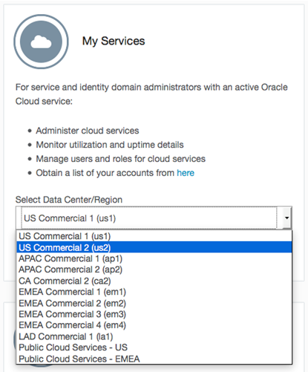

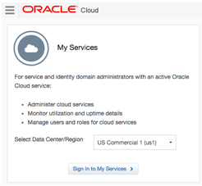
Database Cloud Service
https://cloud.oracle.com

Slide 62
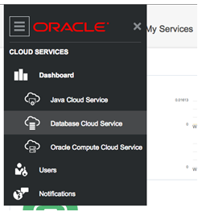
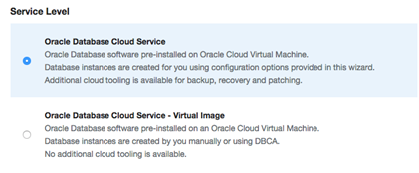

Database Cloud Service

Slide 63
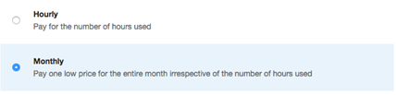
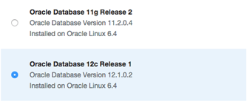
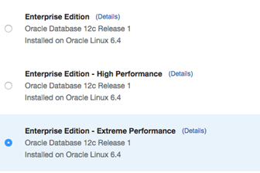
Database Cloud Service

Slide 64
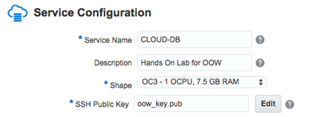
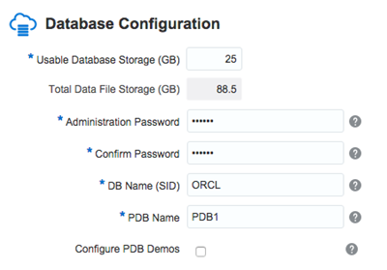
Database Cloud Service

Slide 65
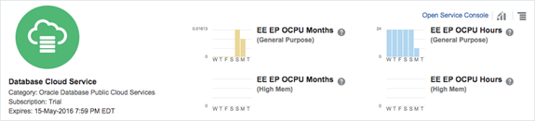
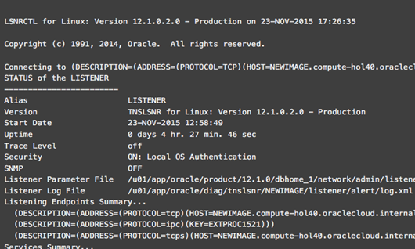
Database Cloud Service – Pronto!

Slide 66

Database Backup Service

Slide 67

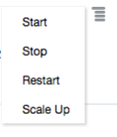
Database Cloud Service – Elasticidade

Slide 68


Database Cloud Service – Elasticidade

