Slide 1
Oracle 12c Best Practices for Highly Available Oracle Databases
By Carlos Pimentel
March, 2016

Slide 2
Goal
Understand High Availability Concept
Understand Active Data Guard Concept
Required Software and License
SCAN Listener
Services
Role-based database services
TNS Configuration for HA
How is CNAMES used for?

Slide 3
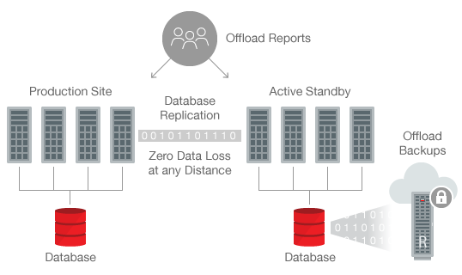
Understand High Availability Concept

Slide 4
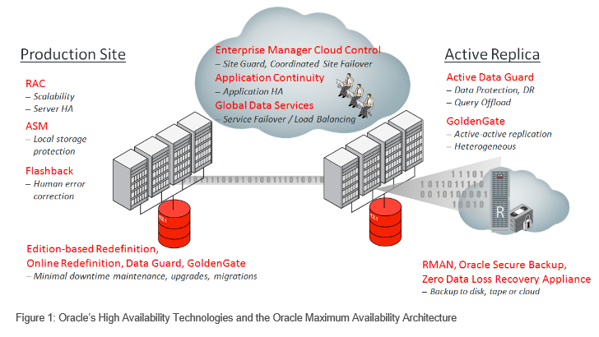
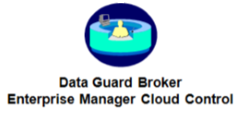
Understand Active Data Guard Concept

Slide 5
Required Software and License
Enterprise Edition
+Options
Real Application Cluster
Active Data Guard

Slide 6
What is the new in 12c?

Slide 7
What is the new in 12c?

Slide 8
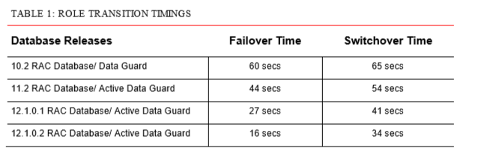
Role Transition Evolution

Slide 9
The Database Pillars of High Availability
Scan Listener
Load Balance - DNS
Listener Redundancy
Services
Load Balance workload based
Preferred Instances
Client Configuration
Connect Settings
Timeout config
TAF
Services

Slide 10
SCAN Listener Single Client Access Name
Define a SCAN using the corporate DNS (Domain Name Service)
First Execution nslookup proddbscn.example.com Server: 143.166.220.125 Address: 143.166.220.125#53 Non-authoritative answer: Name: proddbscn.example.com Address: 10.178.116.225 Name: proddbscn.example.com Address: 10.178.116.226 Name: proddbscn.example.com Address: 10.178.116.224 | Second Execution nslookup proddbscn.example.com Server: 143.166.220.125 Address: 143.166.220.125#53 Non-authoritative answer: Name: proddbscn.example.com Address: 10.178.116.224 Name: proddbscn.example.com Address: 10.178.116.226 Name: proddbscn.example.com Address: 10.178.116.225

Slide 11
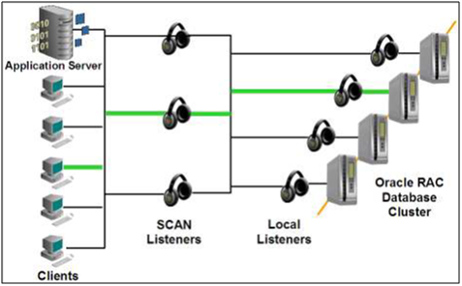
SCAN Listener Single Client Access Name

Slide 12
Why SCAN Listener?
PROD =
(DESCRIPTION =
(ADDRESS = (PROTOCOL = TCP)(HOST = prddb01-vip.us.dell.com)(PORT = 1521))
(ADDRESS = (PROTOCOL = TCP)(HOST = prddb02-vip.us.dell.com)(PORT = 1521))
(ADDRESS = (PROTOCOL = TCP)(HOST = prddb03-vip.us.dell.com)(PORT = 1521))
(ADDRESS = (PROTOCOL = TCP)(HOST = prddb04-vip.us.dell.com)(PORT = 1521))
(ADDRESS = (PROTOCOL = TCP)(HOST = prddb05-vip.us.dell.com)(PORT = 1521))
(LOAD_BALANCE = yes)
(CONNECT_DATA=(SERVER=DEDICATED)(service_name=prod)
)
)
PROD =
(DESCRIPTION =
(ADDRESS = (PROTOCOL = TCP)(HOST = prdbscn.us.dell.com)(PORT = 1521))
(LOAD_BALANCE = yes)
(CONNECT_DATA=(SERVER=DEDICATED)(service_name=prod)
)
)

Slide 13
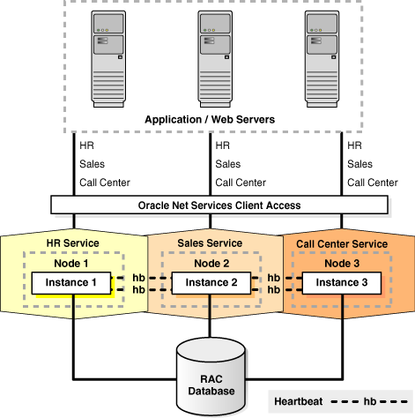
Services

Slide 14
Services Benefits
Dynamic Resource Allocation
High Availability
TAF
Tuning and Monitoring
Role Based
Resource Management
Database Jobs

Slide 15
Role-based database services
We can control the startup of database services assigning a Database role.
-l PRIMARY, PHYSICAL_STANDBY, LOGICAL_STANDBY and
SNAPSHOT_STANDBY
A database service will automatically start based in its role if the service is AUTOMATIC and the ROLE matchs with Database ROLE
srvctl add service -d prod -s prod_adg_sql -r prod1, prod2, prod3
-l physical_standby -y AUTO

Slide 16
Services Example
Using Services and Scan Listener with RMAN
prod_all_instances=
(DESCRIPTION=
(ADDRESS_LIST=
(ADDRESS=(PROTOCOL=tcp)(HOST=proddbscn.us.dell.com)(PORT=1521)))
(CONNECT_DATA=(SERVICE_NAME=prod_all_instances)
))
Service name: prod_all_instances
Cardinality: 6
Service role: PRIMARY
Preferred instances: prod1, prod2, prod3, prod4, prod5, prod6
Available instances:

Slide 17
Services Example
connect target /
CONFIGURE DEVICE TYPE disk PARALLELISM 24;
CONFIGURE CHANNEL DEVICE TYPE disk CONNECT sys/@prod_all_instances;
CONFIGURE DEFAULT DEVICE TYPE TO disk;
run {
set controlfile autobackup format for device type disk to '/bkp/%F.bck';
backup as compressed backupset incremental level 0 filesperset 1 format '/bkp/full_db_%d_t%t_s%s_p%p'
database include current controlfile;
backup as compressed backupset filesperset 10 format '/bkp/full_arch_%d_%s_%p' archivelog all;
}
Starting backup at 06-NOV-15
allocated channel: ORA_DISK_1
channel ORA_DISK_1: SID=2529 instance=prod2 device type=DISK
allocated channel: ORA_DISK_2
channel ORA_DISK_2: SID=3518 instance=prod4 device type=DISK
allocated channel: ORA_DISK_3
channel ORA_DISK_3: SID=5539 instance=prod3 device type=DISK
allocated channel: ORA_DISK_4
channel ORA_DISK_4: SID=3524 instance=prod6 device type=DISK
allocated channel: ORA_DISK_5
channel ORA_DISK_5: SID=2767 instance=prod5 device type=DISK
allocated channel: ORA_DISK_6
channel ORA_DISK_6: SID=3534 instance=prod2 device type=DISK
allocated channel: ORA_DISK_7
channel ORA_DISK_7: SID=1019 instance=prod3 device type=DISK
allocated channel: ORA_DISK_8
channel ORA_DISK_8: SID=1273 instance=prod4 device type=DISK

Slide 18
TNS configuration for HA
PROD =
(DESCRIPTION_LIST=
(LOAD_BALANCE=OFF)
(FAILOVER=ON)
(DESCRIPTION=
(CONNECT_TIMEOUT=5)
(TRANSPORT_CONNECT_TIMEOUT=3)
(RETRY_COUNT=3)
(ADDRESS_LIST=
(LOAD_BALANCE=ON)
(ADDRESS=(PROTOCOL=TCP)(HOST=proddbscn.us.dell.com)(PORT=1521)))
(CONNECT_DATA=(SERVICE_NAME=PROD_FORMS_N_WEB))
)
(DESCRIPTION=
(CONNECT_TIMEOUT=5)
(TRANSPORT_CONNECT_TIMEOUT=3)
(RETRY_COUNT=3)
(ADDRESS_LIST=
(LOAD_BALANCE=ON)
(ADDRESS=(PROTOCOL=TCP)(HOST=proddrdbscn.us.dell.com)(PORT=1521)))
(CONNECT_DATA=(SERVICE_NAME=PROD_FORMS_N_WEB))
)
)

Slide 19
TNS configuration for HA
SCAN LISTENER
Service “prod_forms_n_web" has 5 instance(s).
Instance “prod1", status READY, has 1 handler(s) for this service...
Instance "prod3", status READY, has 1 handler(s) for this service...
Instance "prod4", status READY, has 1 handler(s) for this service...
Instance "prod5", status READY, has 1 handler(s) for this service...
Instance "prod6", status READY, has 1 handler(s) for this service...
LOCAL LISTENER NODE 1
Service “prod_forms_n_web" has 1 instance(s).
Instance “prod1", status READY, has 1 handler(s) for this service...

Slide 20
How is CNAMES used for?
CNAME Record
It is short abbreviation for Canonical Name
Provides an alias name for same hostname
Helps create subdomains
CNAMES is really useful for server replacement purpose. It avoids changes in app network configuration.
We don’t need use CNAME in a database switchover.

Slide 21
Q&A

